Slide 1
Università degli Studi di Verona
Laurea Magistrale in Data Science - Corso Cybercrime
a.a. 2025-2026
PROFILING CYBERCRIMINALS
Prof. Barbara Vettori
08.04.2026

Slide 2
Outline
Who are cybercriminals? Findings from scientific literature
Methodological issues

Slide 3
1. Who are cybercriminals? Findings from scientific literature

Slide 4
From stereotypes to research questions
stereotypes (“nerds”—bright but socially inept; very high IQs and technical knowledge; male, usually teenagers, never violent, all neatly fit one profile)
Rogers (2011): no unique characteristics
different studies, different research questions dealing with the profiling of cybercriminals (e.g. what is the profile of the international cybercriminal? are cybercriminals intellectually superior to traditional criminals? what are their motives?)

Slide 5
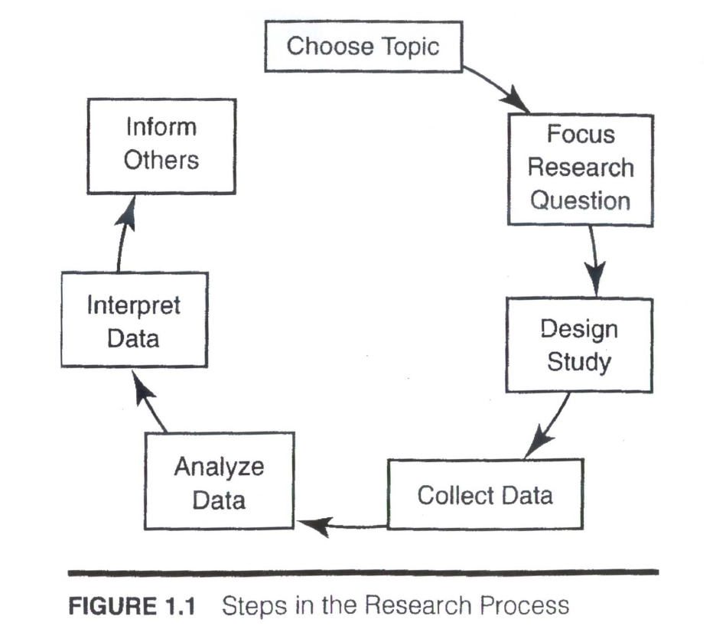
Framework for analysis

Slide 6
Profiling the international cyber offenders in the US
Hadzhidimova and Payne (2019) focus on characteristics of international cyber offenders prosecuted in the U.S.
Methodology: data from U.S. Department of Justice press releases, 01.2009- 12.2017; sample of 225 offenders citizens of another country; statistical analysis
average age: 34,78 y; male (94%); mainly from China (26.7%), Romania (11.6%) and Russia (7.1%); more than two thirds of offenders (68.4%) work in groups; cyber ​​fraud and hacking most committed crimes
sentencing patterns: prison sentences; sentence lenght of African citizens significantly higher

Slide 7
Cybercriminals’ motives/drives
Taylor (1999): 6 drives: addiction, curiosity, boredom, power, recognition, politics
Rogers (2006) divides cybercriminals (both cyber-dependant and cyber-enabled) in 8 groups
Brewster (2015): hackers’ motivations grouped into the following categories (political, ideological, commercial, emotional, informative and promotional, financial, personal, exploitation)

Slide 8
Cybercrim., trad. criminals and non criminals’ intellectual capabilities
Schiks (2022), research question: do cybercriminals have higher intellectual capabilities than traditional criminals / general population? Focus on cyber-dep. criminals
Methodology: data from Statistics NL; comparison of CITO-test scores of 143 cybercriminals, 143 traditional criminals and 143 non-criminals
Results: cyber_x0002_criminals have significantly higher CITO test scores compared to traditional criminals and significantly lower CITO test scores compared to non-criminals

Slide 9
Comparing cybercriminals & traditional criminals over the life course
Krananberg (2018): analysis of cyber-offending over the life_x0002_course; focus on cyber-dependent crimes
examines the extent to which life circumstances in both private and professional life (household composition/employment/education) are differentially related to whether an individual commits cybercrime or traditional crime
analysis of longitudinal police data and population registration data of all suspects of cybercrime and traditional crime in NL in the period of 2000–2012

Slide 10
Comparing cybercriminals & traditional criminals over the life course
effects of household composition on cyber-offending, as in traditional offending:
cohabiting makes a person less likely to commit a cybercrime than when that s/he lives alone
compared to living alone, single-parenthood increased an individual’s likelihood of committing a cybercrime as well as a traditional crime: having a partner in a household as source of informal social control
employment and enrollment in education are not statistically significantly related to cyber-offending, whereas they reduce the likelihood of traditional offending

Slide 11
The hybrid criminal
Results from the interaction human being / machine
Hayward and Maas (2021):
Crimes WITH artificial intelligence (AI)
Crimes AGAINST AI
Crimes BY AI

Slide 12
2. Methodological issues

Slide 13
Methodological issues
Meta analysis by Bada and Nurse (2021)
studies on the profile of cybercriminals are lacking because:
no common definitions; sometimes general lens (not specific types of cybercriminals)
no standard approach to studying criminal behavior online, mainly focus on individual cases of cybercriminals
limited research on personality traits & online criminal behavior online
no data / great difficulty in accessing data
limited focus (mainly hackers); overall, perpetrators of cyber-assisted crimes are not studied

